Slide 1
E-Commerce with Collaborative Filtering
Presented By
Name : Raghavendra R
USN : 1BM16MCA29

Slide 2
Abstract
The main objective is to provide an effective e-commerce website for a xyz company located in Bangalore.
This system will have the predictive suggesting products for users which usually attracts the users.
The collaborative filtering makes a better search when particular item/product is searched.
The usual UI crashes is being improved.

Slide 3
Existing and Proposed system
Existing System
The existing system had bad UI experience as surveyed thought the users.
Always show irrelevant products which users not even interested and does not do any predicting job.
Proposed System
This system will have the predictive suggesting products for users which usually attracts the users.
The collaborative filtering makes a better search when particular item/product is searched.
The new UI will never crashes while users are surfing in the website.

Slide 4
Hardware and software specifications
Hardware Specifications
Software Specifications
Processor | Intel core i3
Processor speed | 1.8GHz
RAM | 2-4GB
Hard disk Capacity | 500GB(Minimum)
Operating system | Windows 7 and above
Technology | Python
Web Technologies | HTML 5, CSS, Java Script
IDE | PYCharm
Database | MYSql

Slide 5
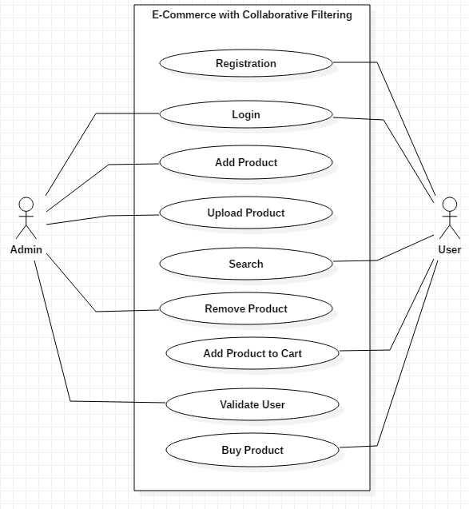
UML diagrams
Use case Diagram

Slide 6
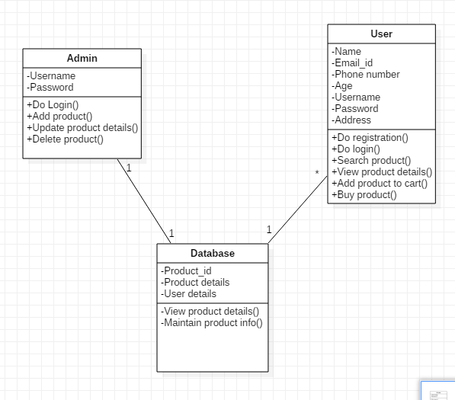
Class Diagram

Slide 7
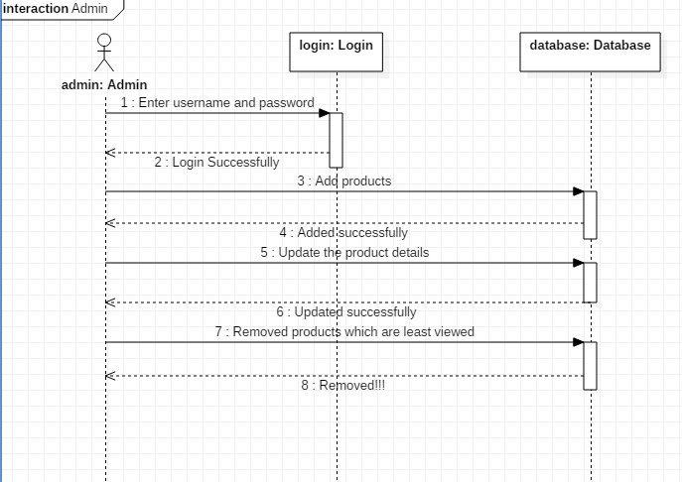
Sequence Diagram
Admin

Slide 8
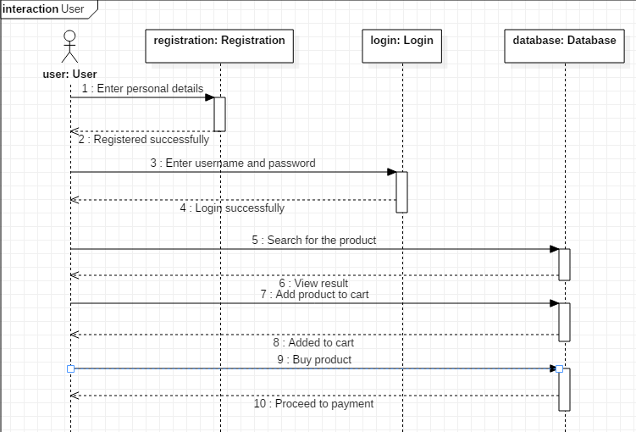
Sequence Diagram
User

Slide 9
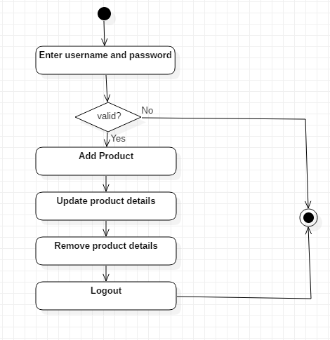
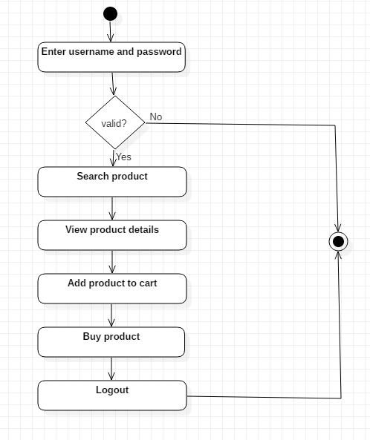
Activity Diagrams
Admin User

